Slide 1
Sémi összehasonlító nyelvészet
BMA-HEBD-303
Biró Tamás
2014. november 26.

Slide 2
Házi feladat jövő szerdára

Slide 3
Olvasandó + házi feladat
Olvasandó: Bennett 251–260, Sém fiai 345–395,
Dévényi-Iványi 3–17 (rövidesen a honlapon is).
  Készítsen listát az elírásokról, nyomdahibákról.
2. Szír írás:
A Brown–Driver–Briggs (BDB) bibliai héber szótárban keressen
tíz olyan szócikket, amelyben szír rokon szó is szerepel.
„Transkribálja” a szír szót a Bennett 252. oldalán található táblázat
és a 254–255. oldalakon található magyarázat segítségével.
Emailben: biro.tamas@btk.elte.hu. Határidő: kedd dél (12:00).

Slide 4
Az írásról

Slide 5
Miért (nem) kell tudnia egy sémi nyelvésznek az írásról?
Az írás nem része a nyelvnek:
  Kulturális invenció
  Nagyon sok nyelv nem rendelkezik írásbeliséggel.
  Írásrendszer vagy helyesírás változása ≠ nyelv változása
Az ismert sémi nyelvek mindegyikét írásbeliséggel rendelkező kultúrában beszélték. Az írott nyelv normatív hatása befolyásolta a nyelv fejlődését.
A „híres” sémi nyelvek rendelkeznek írásbeliséggel.
A régebbi sémi nyelveket, ill. a sémi nyelvek régebbi állapotát csak írott forrásokból ismerjük.

Slide 6
Mit kell (illik) tudnia egy sémi nyelvésznek az írásról?
Készség: más írásrendszerrel publikált nyelvi adatokat elolvasni. (Nem mindig írják át nekünk.)
Megérteni, hogy mely nyelv esetén milyen bizonytalanságot okoz az, hogy az adott
nyelvi adatokhoz csak valamely írásrendszer „szemüvegén” keresztül férünk hozzá.
Írásrendszerek kialakulása és története, paleográfia, az egyes írásrendszerek
rokonsága: a nem-nyelvészek szerint
ez a terület a mi kompetenciánk.

Slide 7
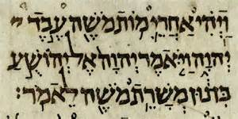
Az átírás folyamata
(V.ö. Beyond Babel, pp. 21-22)
Eredeti forrás, annak fotója, rajza.
Írásjelek beazonosítása: א ב ג…
Transzliteráció: átírás latin betűkkel úgy, hogy abból az eredeti írásmód még egyértelműen visszafejthető legyen. De a transzliteráció már részben értelmezés is. Például: בֵי = bēy vagy bê ?
Normalizáció: mintha az adott nyelvnek létezne
egy standard, a kiejtést (részben) tükröző,
latinbetűs helyesírása. Az adott nyelvet nem ismerő olvasó számára is hozzáférhetővé válik a szöveg.
Fordítás modern nyelvre

Slide 8
History of the alphabet

Slide 9
From pictograms to a writing system
Source: Joseph Naveh. Early History of the Alphabet. Magnes Press, 1987.
9

Slide 10
From pictograms to cuneiform and hieroglyphs
Logograms denote whole word.
Disambiguation:
Phonetic complements: show last sounds of word.
Determinatives: denote word class.
Syllabograms
Egyptian: also uniconsonantal signs.
Source: Joseph Naveh. Early History of
the Alphabet. Magnes Press, 1987.
10

Slide 11
Alphabet: the principle of acrophony
Egyptian uniconsonantal signs.
West-Semitic alphabet: consonantal writing.
Proto-Canaanite script
  cca. 1800 BCE: Wadi el-Hol??
  17-16th c BCE: Gezer, Nablus (Shechem), Lachish
  approx. 1500 BCE:
  Proto-Sinaitic inscriptions (discovered by F. Petrie, 1905/06, West Semitic slaves in turquoise mines?)

Slide 12
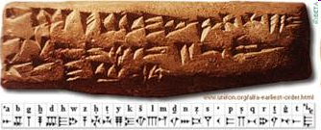
West-Semitic consonantal writings based on the principle of acrophony
West-Semitic alphabet: strongly influenced by Egyptian uniconsonantal signs?
Ugaritic script:
  Akkadian (language & script) was
  also used in Ugarit.
  Developed alphabet (27C + 3V),
  but based on cuneiform:
  Abecedary from Ugarit: order had ritual importance?

Slide 13
Adopting a writing system to another language
Cuneiform: Sumerian => Akkadian => Ugaritic, Luwian, Hittite, Elamite, Persian, Tel el-Amarna glosses
Hieroglyphic: Egyptian => Luwian, etc.
Phoenician => Greek => Latin => English, Dutch, French, Maltese (= an Arabic dialect influenced by English and Italian) etc.
Hebrew => Judeo-languages
Arabic => Persian, Turkish. Cyrillic, etc. to many languages
Problems arising:
Different phonological system: new sounds not present in the source language. Dutch: ch, sj… Hebrew: shin/sin (ayin/rayin?)
Traditions borrowed together with the writing system that do not make sense in the new language: Hebrew spelling in Yiddish, Sumerian logograms in Akkadian.

Slide 14
Further history of the Alphabet
End of 2nd millennium: reduction
of the number of letters.
South-Arabian => Ethiopian
Phoenician, developed into:
- Punic
- Greek => Latin,Coptic, Cyrillic…
- Paleo-Hebrew => Samaritan
- Aramaic =>
- Jewish
- Syriac
- Nabataean, Palmyrene => Arabic; India, Central Asia

Slide 15

Jewish scripts
After Babylonian exile (587-539).
Qumran, First Jewish War (66-70), Bar Kokhba’s revolt (132-135): sporadic use of paleo-Hebrew script (as an identity marker, a national symbol?).
Paleography: very different handwriting styles in medieval manuscripts (Italian, Yemenite, etc. etc. etc.)
Ashkenazi cursive (hand writing) => Israeli cursive.
Sephardic cursive (hand writing): also used for Ladino.
  “Rashi” script: 16th c., developed from Sephardic cursive to differentiate between Bible text and commentary.
1920s: Hebrew stenography. 1936: Hebrew Braille (both left-to-right)
Signs for each letter in Israeli Sign Language (ISL).

Slide 16
Early Hebrew epigraphy
Important inscriptions
from the first temple period

Slide 17
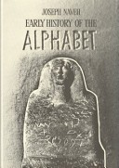
First temple period
First temple period: 10th century – 586 BCE
Epigraphy = study of inscriptions.
Found in archaeological excavations.
Using pre-exilic Hebrew script.
Some famous examples given below.
Recommended, even if not up-to-date introduction: Joseph Naveh. Early History of the Alphabet. Magnes Pr., 1987.
http://en.wikipedia.org/wiki/Gezer_calendar
17

Slide 18
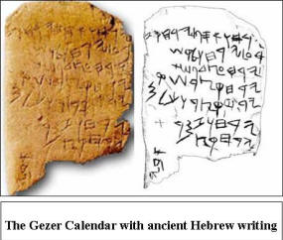
The Gezer calendar
End of 10th century BCE
School children learning agriculture?
“Two months gathering [September-October]
Two months planting [November-December]
Two months late sowing [January-February]
One month cutting flax [March]
One month reaping barley [April]
One month reaping and measuring (grain) [May]
Two months pruning [June-July]
One month summer fruit [August]
Abijah” Source: http://www.truthnet.org/Bible-Origins/4_How_was_Bible_written/Gezer_Calendar_Hebrew.jpg
http://en.wikipedia.org/wiki/Gezer_calendar
18

Slide 19
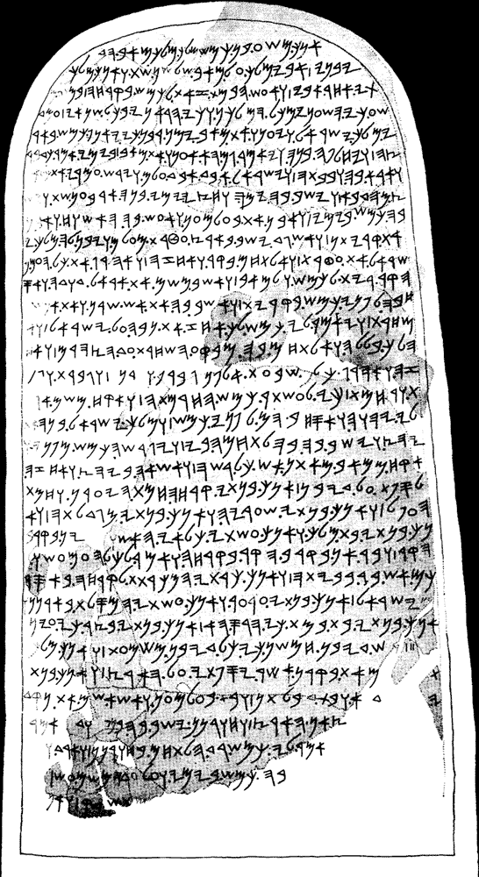

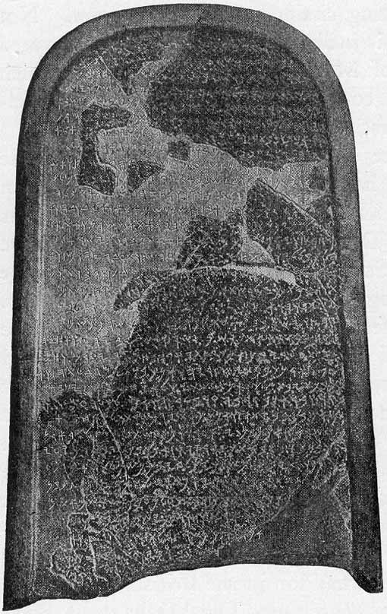
The Mesha stele
9th century
Moabite king’s victory
over house of David.
In Moabite language:
too similar to Biblical
Hebrew? Was it a
general literary style?
Shape of letters: first
distinctive features of
Hebrew writing.
Read text on: http://en.wikipedia.org/wiki/Mesha_stele.
Source of images: http://issachar5.files.wordpress.com/2010/05/mesha-stele.jpg, http://www.houseofdavid.ca/bd_mesha.jpg, http://vadym.web.cern.ch/vadym/images/MeshaSteleInscrip10cmh.gif
http://en.wikipedia.org/wiki/Gezer_calendar
19

Slide 20
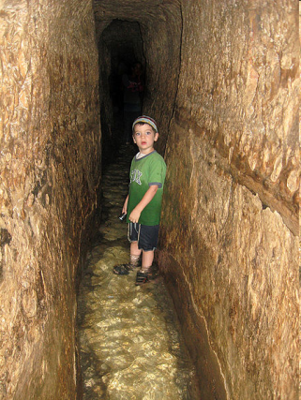
The Siloam (Shiloah) Inscription
2Chron. 32: King Hezekiah building a tunnel
at the Gihon Spring, before the siege of Jerusalem by the Assyrians in 701 BCE.
Happiness when those digging the tunnel
from the two ends finally meet in the middle.
http://en.wikipedia.org/wiki/Gezer_calendar
20

Slide 21
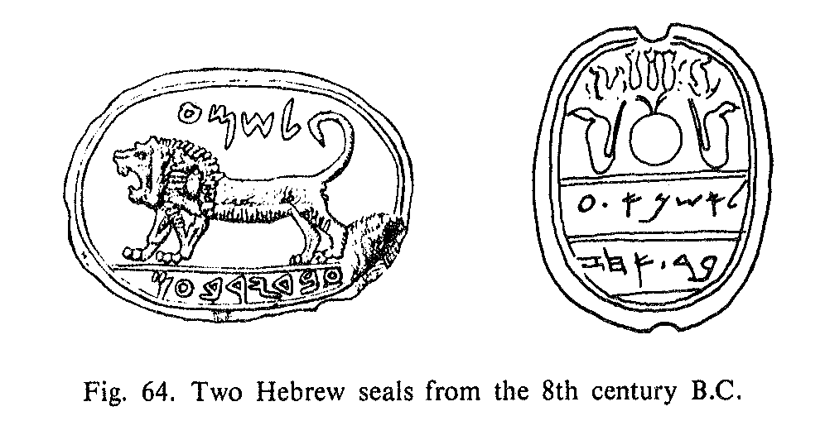
Seals
http://en.wikipedia.org/wiki/Gezer_calendar
21

Slide 22
Jar handles: la-melekh inscriptions
http://en.wikipedia.org/wiki/Gezer_calendar
22

Slide 23
Ostraca
Ostracon: letter (or else) written (with ink, sometimes incised) on a piece of pottery (typically broken off from a vase).
Famous ones in Biblical archeology: Khirbet Qeiyafa (1000 BCE?), Samaria (8th c.), Mesad Hashavyahu (late 7th c.: petition to the local governor), Arad (early 6th c.), Lachish (early 6th c.)...
http://en.wikipedia.org/wiki/Gezer_calendar
23

Slide 24
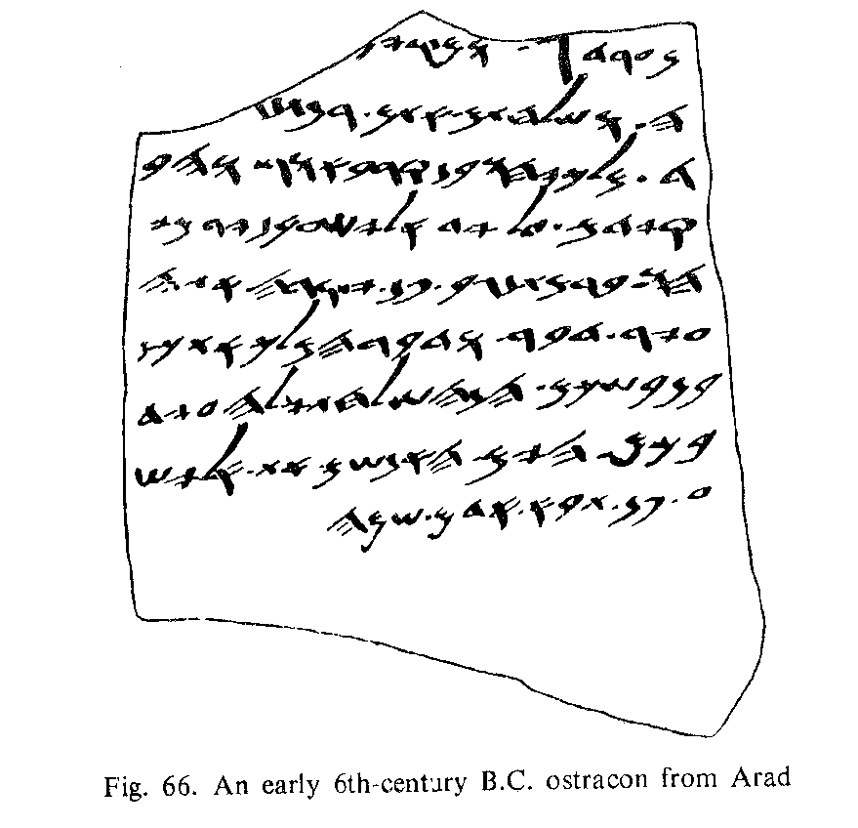
Ostraca
http://en.wikipedia.org/wiki/Gezer_calendar
24

Slide 25
Overview:
Development of the
Paleo-Hebrew script:
1. Gezer calendar: 10th c.
2. Mesha stele: 9th c.
3. Siloam inscription: late 8th c.
4. Seals from the 7th cent.
5. Arad ostraca: early 6th c.
6. Leviticus fragment:
2nd c. BCE.
7. Medieval Samaritan
bookhand.
Upper box: alef to kaf,
lower box: lamed to tav.
http://en.wikipedia.org/wiki/Gezer_calendar
25

Slide 26
Name of the Hebrew letters
Name of the Hebrew letters come from the Phoenician alphabet.
Nice examples of sound changes:
  Phoenician rēš ~ Hebrew rōš, but cf. bərēšīt (Proto-Semitic *rāš, cf. Arabic rās).
  Phoenician bēt ~ Hebrew bayit, status constructus (smichut) bēt. Probably, Proto-NWSemitic * bayt with a diphthong [ay]. It got monophthongized [ay] > [ē] in Phoenician and in the Hebrew status constructus. But in the status absolutus of Hebrew, a second vowel [i] got inserted, [y] became a full vowel, and so the diphthong was eliminated by turning the word into two syllables.

Slide 27
A few words on orthography
Spelling (Werner Weinberg: The History of Hebrew Plene Spelling, HUCP 1985, pp. 1ff):
Initially (10th c. BCE, Gezer and Phoenician inscriptions): extremely defective/chaser:
  בת (for בית),
  ז (for זה),
  לפנ (for לפני),
  שערמ (for שעורים, ‘barley+plural’)
Insertion of matres lectionis at the beginning of the words (more plene/male writing, cf. Mesha):
  כי [ki], בנתי [baniti]
  בנה [bana] and [b'no], cf. פה, כה, שלמה
http://en.wikipedia.org/wiki/Gezer_calendar
27

Slide 28
A few words on orthography
Phonological change (monophthongization): diphthongs turned into monophthongs: [iy] > [i:], [uw] > [u:], [ay] >[e:], [aw] >[o:], [a?] >[a:].
Hence, letters originally denoting consonants/glides, now denote vowels.
Hence, the idea of vowel letters:
  Crucial in non-semitic languages (Greek borrowing the Phoenician alphabet; Persian borrowing the Arabic alphabet; Yiddish and Ladino...)
Biblical Hebrew: matres lectionis sometimes with and sometimes without etymological history.
Late Biblical Hebrew: more plene than classical BH.
Qumran Hebrew: extremely plene spelling.
http://en.wikipedia.org/wiki/Gezer_calendar
28

Slide 29
A few words on orthography
Israeli Hebrew:
rules of the Academy of the Hebrew Language:
  When to use matres lectionis in non-vocalized text (e.g., yod in open syllables, but not in closed ones).
  How to transcribe foreign words:
  e.g. t vs. th, such as in טלפון vs. תאוריה.
Please always remember:
  The writing system is not part of the language system!
  Many languages have no writing system. Some have more wr systems.
  Orthography is not part of grammar!
  Orthography = social convention, changing independently of lg.
  Yet, traditional spelling can help reconstruct past stages the languages.
  Do not confuse sound with letter!
http://en.wikipedia.org/wiki/Gezer_calendar
29

Slide 30
Viszlát jövő szerdán!

